Slide 1
NATIONAL HYDROLOGY PROJECT
Directorate
Groundwater Surveys and Development Agency
Water Supply and Sanitation Department,
Government of Maharashtra,
Pune

Slide 2
Details of SPMU
Sl. No | Positions under NHP-SPMU | Name; Designation and Division of Officer
1 | Coordinator (Principal Secretary Level) | Shri. Shyam Lal Goyal, Additional Chief Secretary, W.S.S.D. Mantralaya, Mumbai.
2 | Nodal Officer (Director) | Shri. Shekhar Gaikwad (IAS), Director, Groundwater Surveys and Development Agency, Pune.
3 | Additional Director | Dr. I.I. Shah, Additional Director, Groundwater Surveys and Development Agency, Pune.
 | Technical Sections
4 | Sr. Hydro-Geologist - 1 no. | Dr. Vijay Pakhmode, Deputy Director, Groundwater Surveys and Development Agency, Pune .
5 | Geo-physics - 1 No. | Shri. Bhaskar, Chief Geophysicist, Groundwater Surveys and Development Agency, Pune.
6 | GW Modeler - 2 Nos. | --
7 | Hydro-met Instrumentation Expert (AE/AEE) 2 nos. | --
8 | Database Management Expert - 1 nos. | Shri. P.S. Kadam, System Analyst, Groundwater Surveys and Development Agency, Pune.
9 | IT/ Web Designing Expert - 1nos | To be placed
10 | GIS Expert - 1 nos | To be placed
11 | Data Entry Operator - 2 nos. | Smt. Y.V. Badge, Junior Geologist, Groundwater Surveys and Development Agency, Pune.
 | Finance
12 | Assistant Director (MFAS) | Smt. Gitanjali Supate, Assistant Director, Groundwater Surveys and Development Agency, Pune.
13 | Accounts Officer - 1 nos | Smt. V.V. Pharne, Account Officer, Groundwater Surveys and Development Agency, Pune.
14 | Asst. Accounts Officer - 1 nos. | Shri Chetan Bankar, Senior Clerk, Groundwater Surveys and Development Agency, Pune.
 | Procurement
15 | Procurement Expert (Instrument/ IT related) 1 nos | Shri . P.S. Kadam, Planning Officer, Groundwater Surveys and Development Agency, Pune.
16 | Procurement Expert (Goods and Consultancy) 1nos | Shri. Vijay Janrao, Administrative Officer, Groundwater Surveys and Development Agency, Pune.
17 | M & E
18 | MIS Expert - 1 nos. | Smt. Y.V. Badge, Junior Geologist, Groundwater Surveys and Development Agency, Pune.
19 | M & E Expert - 1 Nos. | Smt. Y.V. Badge, Junior Geologist, Groundwater Surveys and Development Agency, Pune.

Slide 3
Fund Received:
For FY 2016-17 : Rs. 38.50 Lakhs
For FY 2017-18 : Rs. 1.77 Cr.
Expenditure till date: Nil

Slide 4
Major Procurement Items in PIP
Item Code | Item | Amount (In Lakhs)
A1.4.01 | Procurement of DWLR Telemetry for existing GW Monitoring Wells | 522.2
A1.8.01 | Vehicle mounted pumping test units for aquifer performance complete set | 45
A3.4.01 | Hardware and software for state, regional, district data centres such as desktop, printer, scanner, plotter, photocopier etc | 85.3
A3.4.02 | Laptop | 7.5
B2.2.01 | Satellite imaginaries/products | 20
B2.3.01 | Digitization of data, records, reports etc | 20
B2.6.01 | Printing of Information Broachers | 20
D1.4.01 | Video conferencing equipments | 90
D3.1.01 | Setting up of SPMU Office | 50
D3.1.02 | Procurement of vehicle | 32

Slide 5
Major Procurement Items in AWP 2016-17
Item Code | Item | Amount (In Lakhs)
A3.4.01 | Desktop computer with software, antivirus and accessories etc | 7.00
 | Laptop | 3.00
 | Printer, A4 | 2.50
 | UPS | 0.5
 | Ancillary accessories such as pen drive, hard disk etc | 0.5
B2.3.01 | Digitization of data, records, reports etc | 2.0
B2.6.01 | Printing of Information Brouchers | 2.0

Slide 6
Major Procurement Items in AWP 2017-18
Item Code | Item | Amount (In Lakhs)
A1.4.01 | Procurement of DWLR Telemetry for existing GW Monitoring Wells | 209
A1.8.01 | Vehicle mounted pumping test units for aquifer performance complete set | 15
B2.6.01 | Printing of Information Brouchers | 3
D1.4.01 | Video conferencing equipments | 30
D3.1.02 | procurement of vehicle | 8
D3.2.01.03 | Stationary | 10

Slide 7
Physical Progress
Admistrative Approval of Govt. Of Maharashtra for PIP, AWP 2016-17 and AWP 2017-18 is awaited.
(This office letter No. ³Öæ.ÃÖ.×¾Ö.µÖ./¸üÖ.•Ö.¯ÖÏ./834/2017 dt. 22/11/2016)
For Construction of State Level Informatics Centre Architecture appointed.

Slide 8
Status of Bid Document
Preparation of Bid document will be followed after
administrative sanction from Government of Maharashtra

Slide 9
Status of Various Studies/PDS etc.
PDS Presentations delivered at NIH, Roorkee after first review of NIH, Roorkee.
PDS on Identification of causes for water level declination near by coal mine area of Nagpur Region.
Estimation of Aquifer Hydraulic Parameters in Different Geological Formation.
PDS on Aquifer in Latur district and design after survey.
Fluoride (F) Distribution in Groundwater & F Contamination in Food-Chain.

Slide 10
Status of Hydromet Station, Reconciliation with state, CGWB, CWC,IMN etc.
Regarding this Sub-Committee Meeting was scheduled on 27-28 July 2017 at Ahmedabad but due to flood condition in Gujarat the meeting was postponed.

Slide 11
Status of State WRIS
The information of groundwater levels and rainfall from 1971 to till date is managed
And saved in Groundwater Estimation and Management System (GEMS),
still it is in working condition in Maharashtra.

Slide 12
Status of Public Finance Management System (PFMS)
PFMS Registration done.
Login created.

Slide 13
Any Other Issues:
Earlier As per PIP, Under Component D3.1.03, instead of hiring of vehicles sanctioned, accord sanction to purchase vehicles for field survey since this department have drivers and vehicles maintains section. (Approx. required Funds for 45 vehicles is Rs.225 Lakhs).
Earlier as per PIP Under Component A3.4.01, instead of 10 computers, 4 laptops, 10 printers and 10 UPS sanctioned (Fund Allocated Rs.13.5 Lakhs upto March, 2018), actually the state have three tire system and to maintain the information system related to groundwater, this office requires 50 computers, 10 laptops, 45 A4-B/W printers for state, regional and district level offices (Aprrox. Required Funds: Rs. 40 Lakhs).

Slide 14
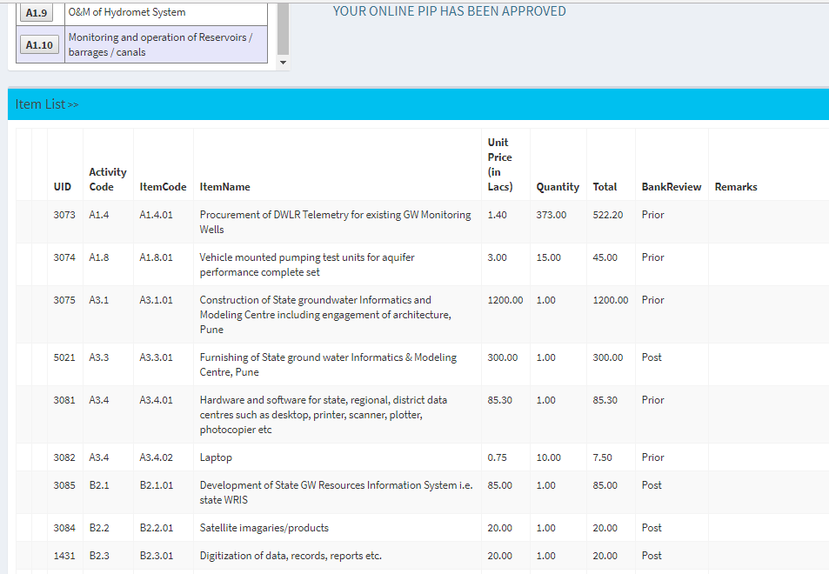

Slide 15
